Slide 1
CSE 215 (Database)
Introductory Lecture
Md. Saiful Islam
Lecturer
Department of CSE, BUET

Slide 2
Course Outline
Week | Topics | Teacher’s Initial
Week 1 | Introduction to Relational Database System and Database Design | MSI
Week 2-3 | Entity Relationship Diagrams | MSI
Week 4 | Database Design Theory, Normalization | MSI
Week 5 | SQL | MSI
Week 6-7 | SQL Constraints Relational Algebra | MSI
Week 8-14 | Indexing, Hashing External Memory Algorithms Query Optimization Transactions Data Recovery | ASML

Slide 3
Reference Books
Book Name | Author | Edition
A First Course in Database Systems | Jeffrey D. Ullman, Jennifer Widom | 2nd
DATABASE SYSTEMS The Complete Book | Hector Garcia-Molina, Jeffrey D. Ullman, Jennifer Widom | 2nd
Database System Concepts | Avi Silberschatz, Henry F. Korth, and S. Sudarshan | 6th or 7th

Slide 4
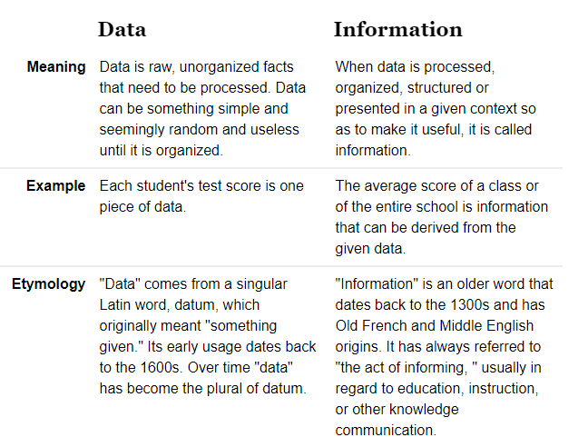
Data vs Information

Slide 5
Data vs Information
Data are bits of information
If we cannot interpret data, it do not add any value
Well interpreted data is the new currency

Slide 6
Database
A large, integrated collection of data
Example: BIIS student database
How to manage such database?

Slide 7
Database Management System (DBMS)
Requirements
Persistent Storage
Programming Interface
Access, and modify data (efficiently)
Transaction Management (concurrent access)
Atomicity
Consistency
Isolation
Durability

Slide 8
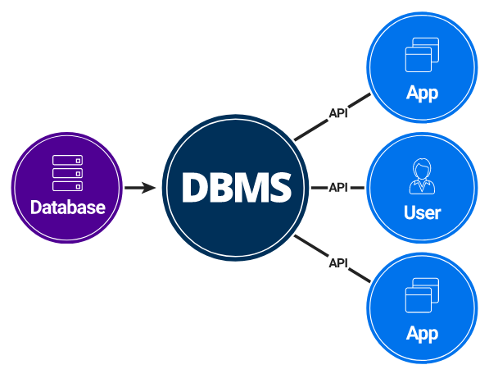
Database Management System (DBMS)
A Database Management System (DBMS) is a piece of software
designed to store and manage databases.

Slide 9
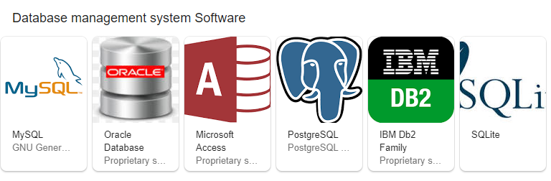
DBMS Examples

Slide 10
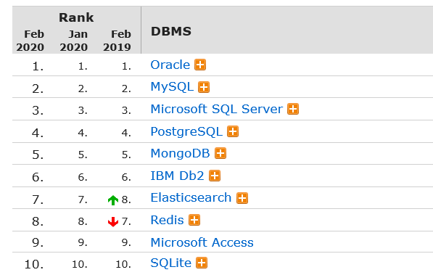
Popularity of DBMS

Slide 11
Key Concepts: Entity
Entity is a object in the world that can
be distinguished from other objects.
A thing, person, place, unit, object or any item about which the data should be captured and stored in the form of properties, workflow and tables.

Slide 12
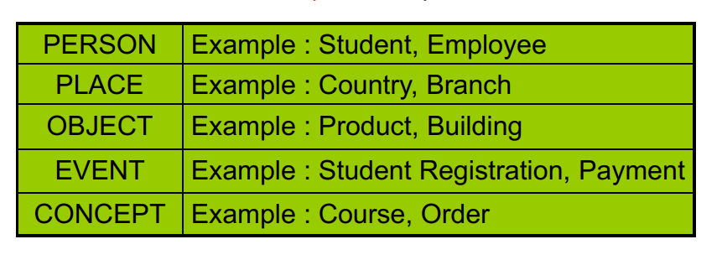
Key Concepts: Entity Set
Entity set is a collection of entities.
In a sense, an entity is an object, and entity set is a class (w.r.t. OOP).

Slide 13
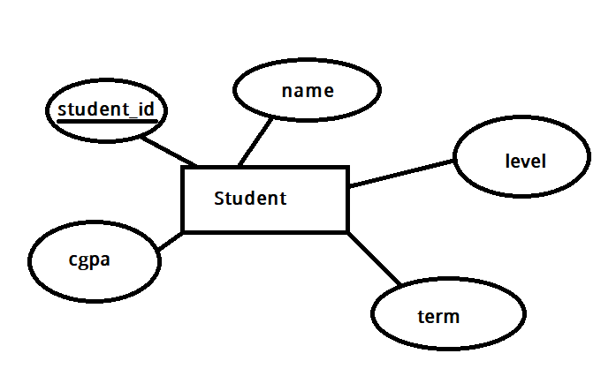
Key Concepts: Attributes
Attributes are used to describe an entity
What can be the attributes of a student?
student_id
name
level
term
cgpa

Slide 14
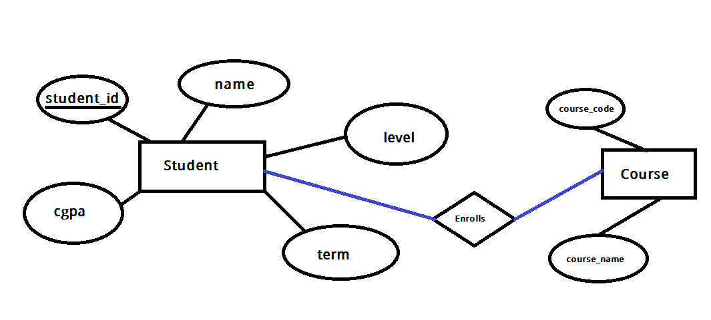
Key Concepts: Relation
A relationship is association among two or
more entities.
Relationships are drawn using diamond

Slide 15
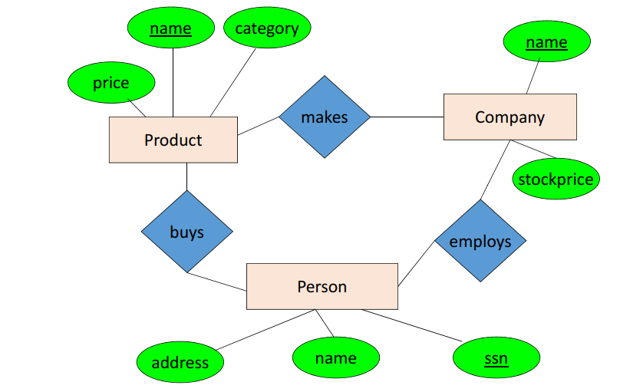
ER Diagram Example

